Slide 1

TOPIC: REAL TIME 3D POSE CLASSIFICATION
GROUP MEMBERS
Members: Enrollment no:
Anupreksha Shukla 20100BTCSDSI07260
Anushka Sitoke 20100BTCSDSI07261
Ashlesha Budholia 20100BTCSDSI07265
Ekta Gupta 20100BTCSDSI07270

Slide 2

REAL TIME 3D POSE CLASSIFICATION
Presentation

Slide 3

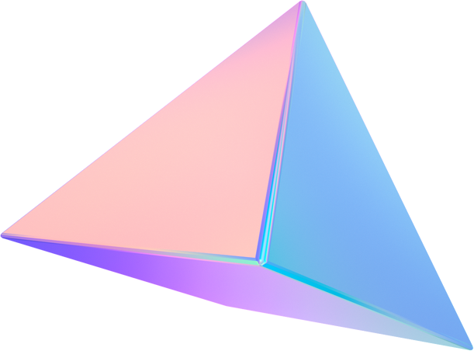
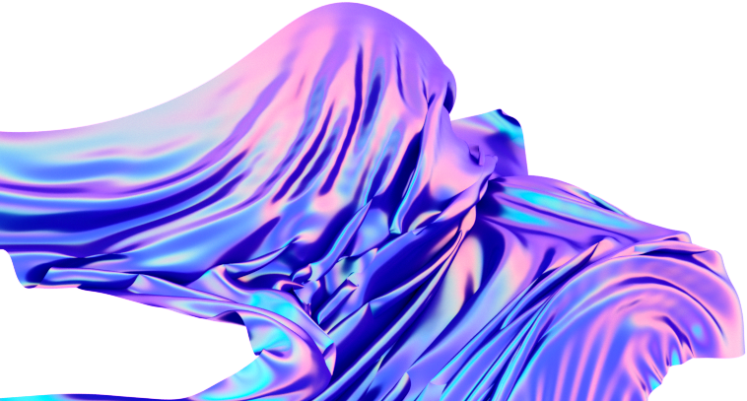

ROLE OF TEAM MEMBER
PROJECT RESEARCH CONECTIVITY WITH FLASK
Anupreksha Shukla Anupreksha Shukla
Anushka Sitoke Ekta Gupta
Ashlesha Budholia
Ekta Gupta
FRONTEND CODE BACKEND CODE
Anupreksha Shukla Ashlesha Budholia
Ekta Gupta Anushka Sitoke

Slide 4

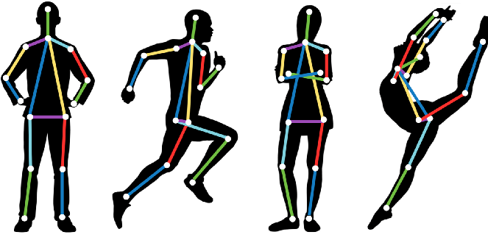
INTRODUCTION
Pose Detection (also known as Pose Estimation) is a widely used computer vision task that enables you to predict humans poses in images or videos by localizing the key body joints (also reffered as landmarks), these are elbows, shoulders, and knees, etc.

Slide 5


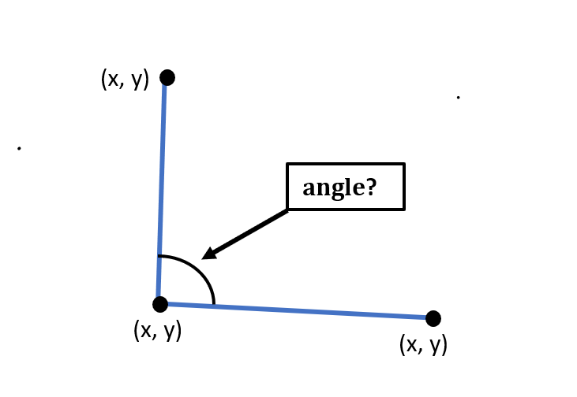
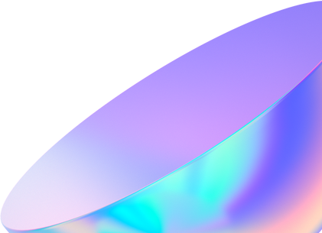
Calculate Angle between Landmarks
The first point (landmark) is considered as the starting point of the first line, the second point (landmark) is considered as the ending point of the first line and the starting point of the second line as well, and the third point (landmark) is considered as the ending point of the second line

Slide 6

Perform Pose Classification
We are Performing three types of Pose Classification
Warrior II Pose
T Pose
Tree Pose

Slide 7
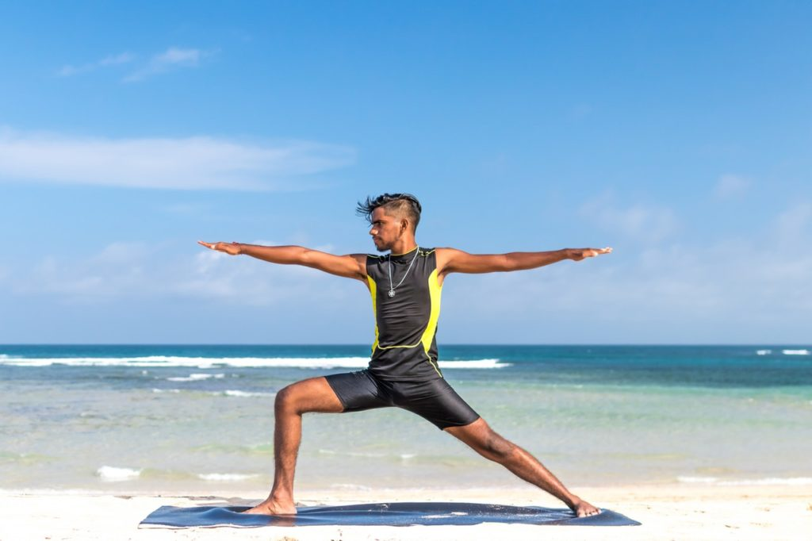
WARRIOR POSE
The Warrior II Pose (also known as Virabhadrasana II) is the same pose that the person is making in the image above. It can be classified using the following combination of body part angles:
Around 180° at both elbows
Around 90° angle at both shoulders
Around 180° angle at one knee
Around 90° angle at the other knee

Slide 8
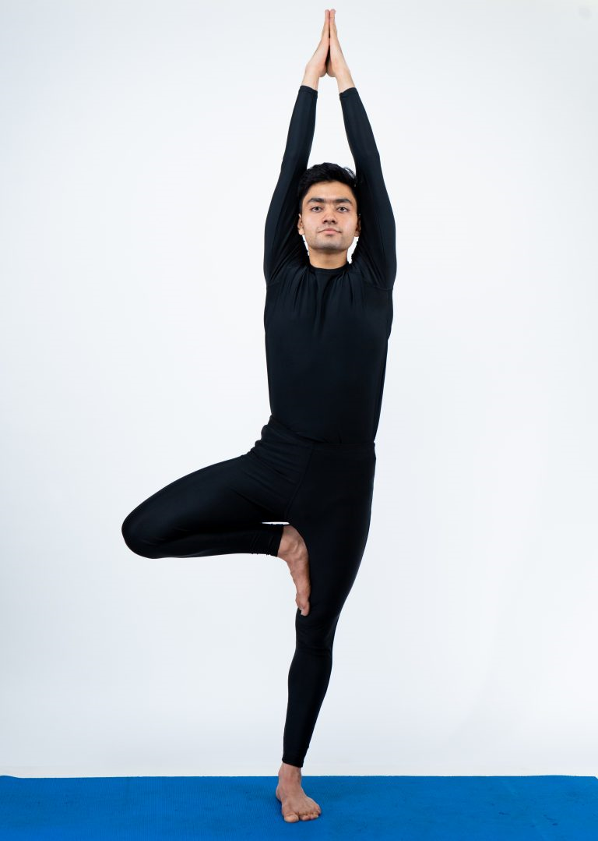
TREE POSE
Tree Pose (also known as Vrikshasana) is another yoga pose for which the person has to keep one leg straight and bend the other leg at a required angle. The pose can be classified easily using the following combination of body part angles:
Around 180° angle at one knee
Around 35° (if right knee) or 335° (if left knee) angle at the other knee

Slide 9
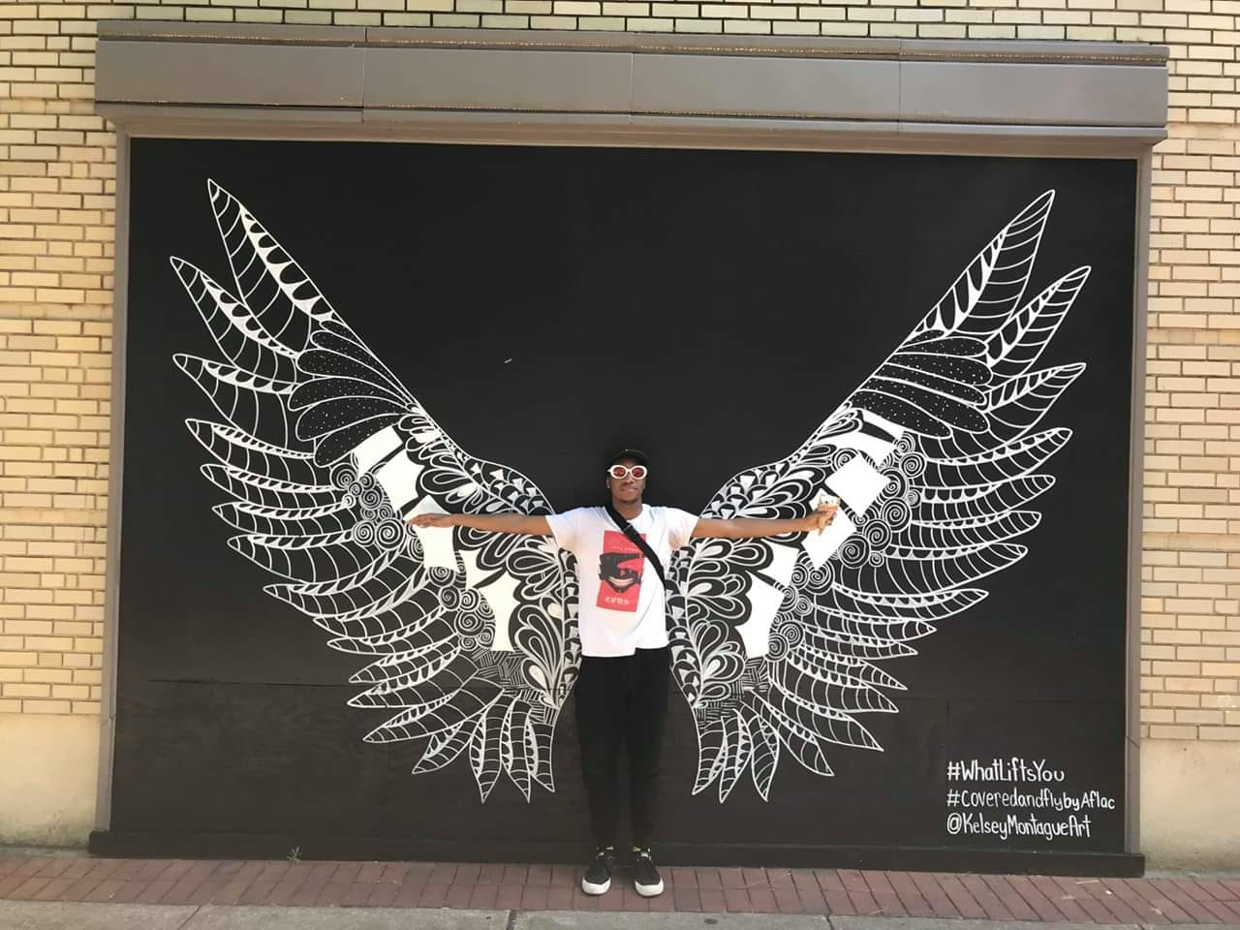
T POSE
T Pose (also known as a bind pose or reference pose) is the last pose we are dealing with in this lesson. To make this pose, one has to stand up like a tree with both hands wide open as branches. The following body part angles are required to make this one.
Around 180° at both elbows
Around 90° angle at both shoulders
Around 180° angle at both knee

Slide 10


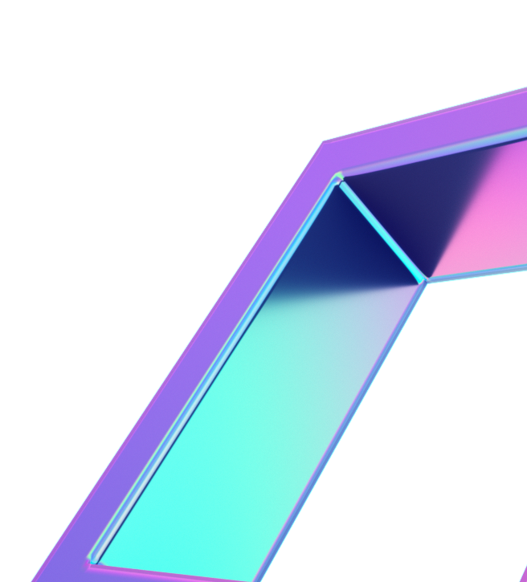
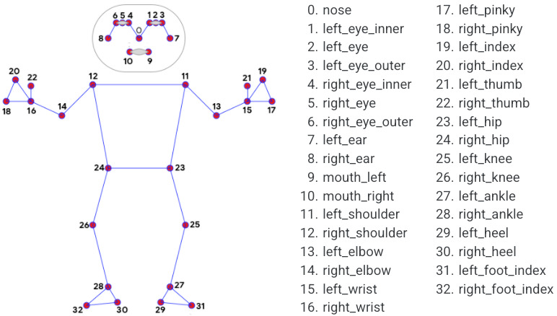
MediaPipe
Provides a robust solution capable of predicting **thirty-three 3D landmarks on a human body in real-time with high accuracy even on CPU. It utilizes a two-step machine learning pipeline, by using a detector it first localizes the person within the frame and then uses the pose landmarks detector to predict the landmarks within the region of interest.

Slide 11
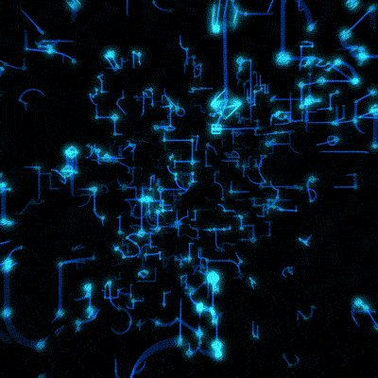
REAL TIME 3D POSE CLASSIFICATION

Slide 12
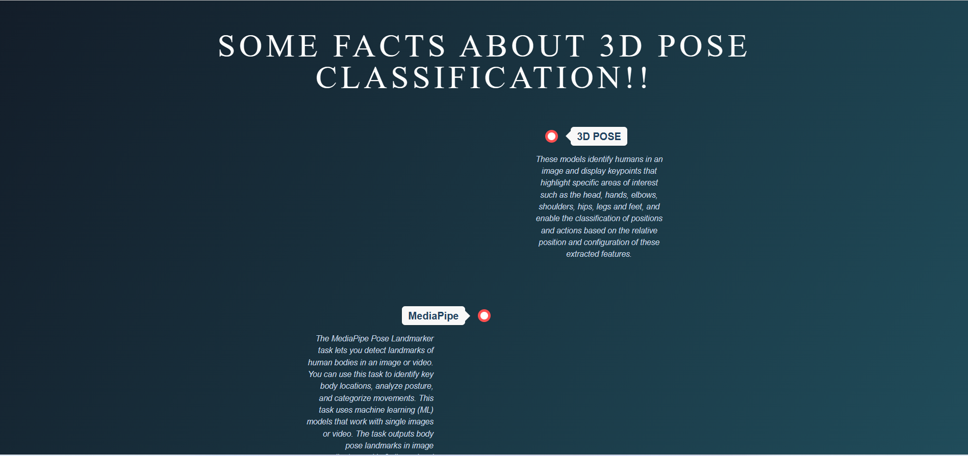

Slide 13
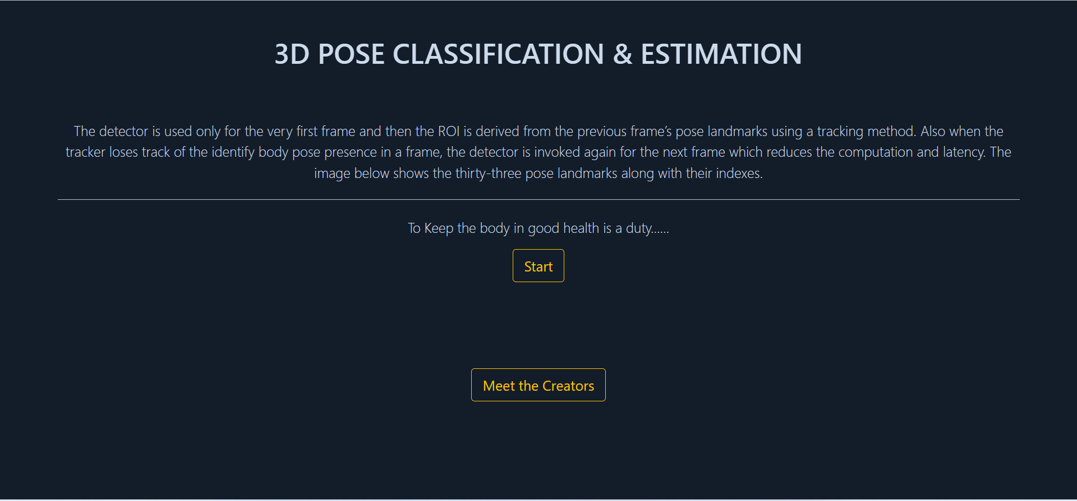

Slide 14

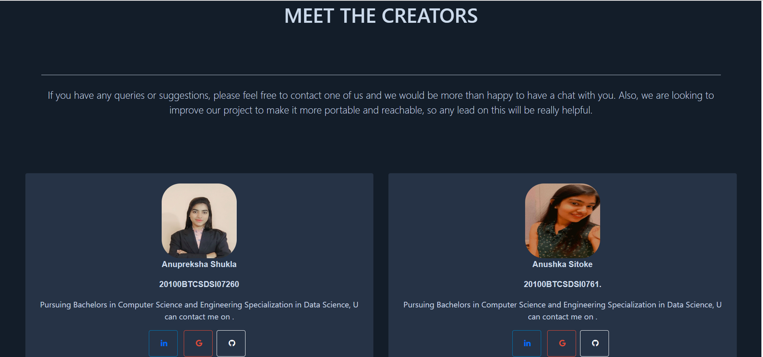

Slide 15
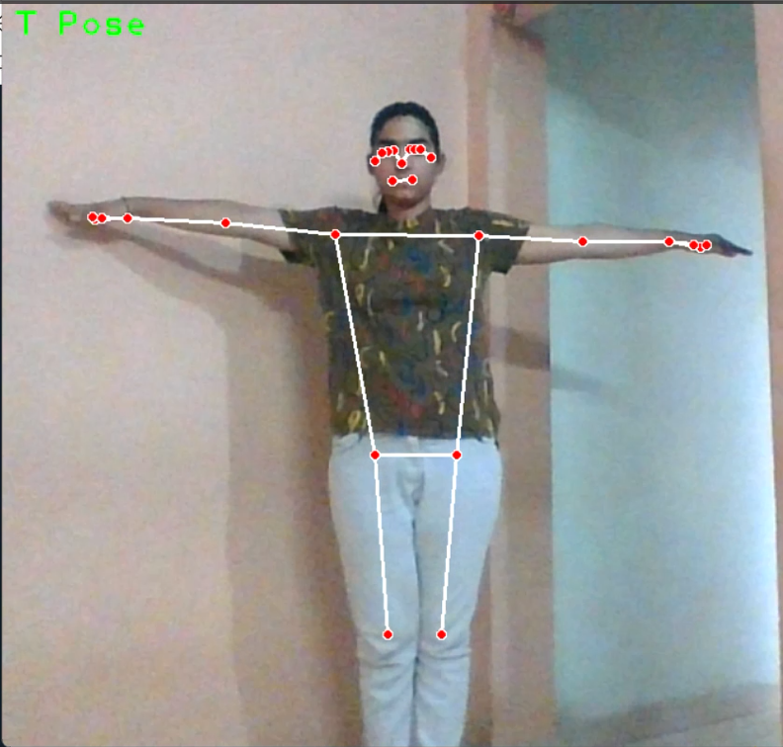
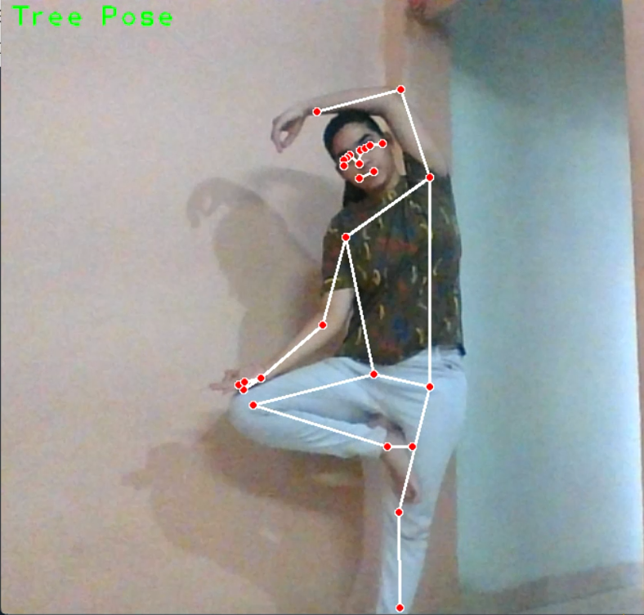
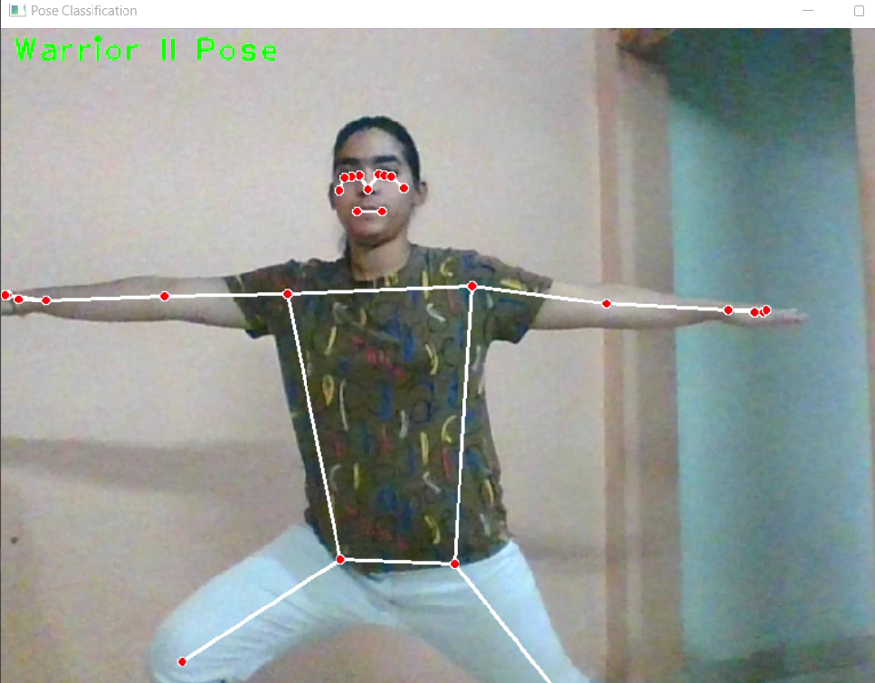

Slide 16


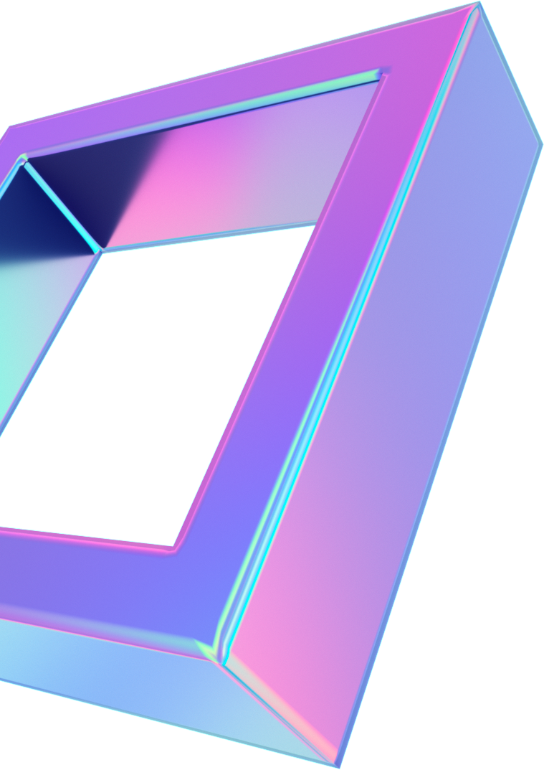
Thank You

